Slide 1
K-Nearest Neighboor Classifiers
Dr Panagiotis Chountas

Slide 2
Classifiers
X1
X2
feature
values
X3
Y
…
Classifier
category
Xn
DB
collection of instances with known categories

Slide 3
Supervised learning & Classification
Given: dataset of instances with known categories
Goal: using the “knowledge” in the dataset, classify a given instance
predict the class of the given instance that is rationally consistent with the dataset

Slide 4
Nearest Neighbor Classifiers
Basic idea:
If it walks like a duck, quacks like a duck, then it’s probably a duck
Compute Distance
Test Record
Training Records
Choose k of the “nearest” records

Slide 5
Instance-Based Learning
Idea:
Similar examples have similar label.
Classify new examples like similar training examples.
Algorithm:
Given some new example x for which we need to predict its class y
Find most similar training examples
Classify x “like” these most similar examples
Questions:
How to determine similarity?
How many similar training examples to consider?
How to resolve inconsistencies among the training examples?
Notes:
Similar inputs map to similar outputs
If not true => learning is impossible
If true => learning reduces to defining “similar”

Slide 6
Voronoi Diagram (deldir Package in R)
kNN rule leads to partition of the space into cells (Voronoi cells) enclosing the training points labelled as belonging to the same class
https://www.youtube.com/watch?v=0YKctwIGumQ

Slide 7
1-Nearest Neighbor
One of the simplest of all machine learning classifiers
Simple idea: label a new point the same as the closest known point
Label it red.

Slide 8
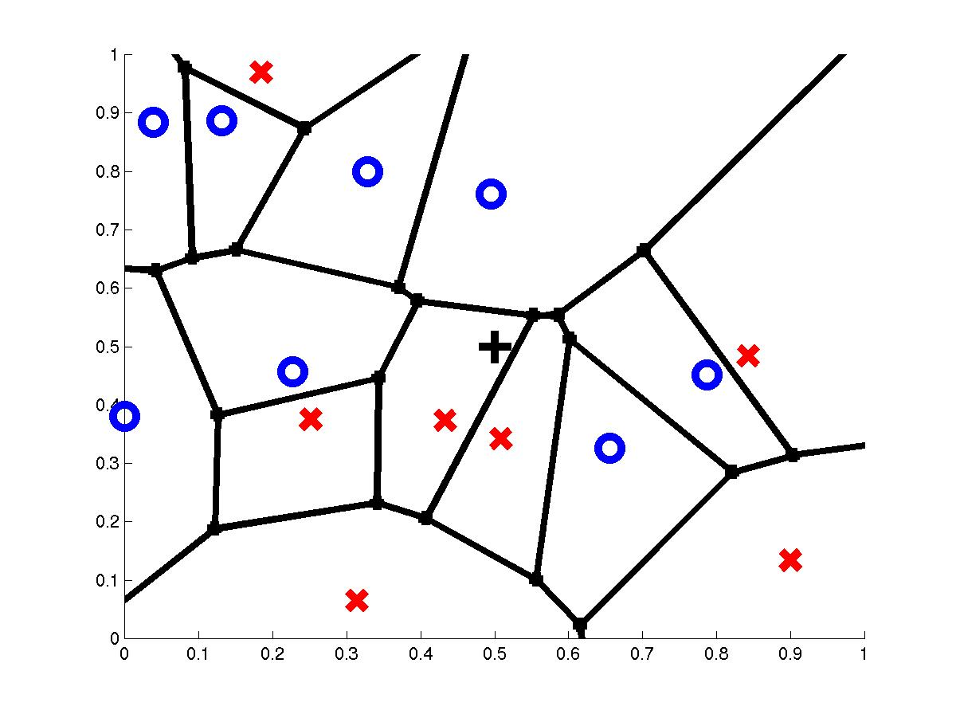
1-Nearest Neighbor
query point q_{f}
nearest neighbor q_{i}

Slide 9
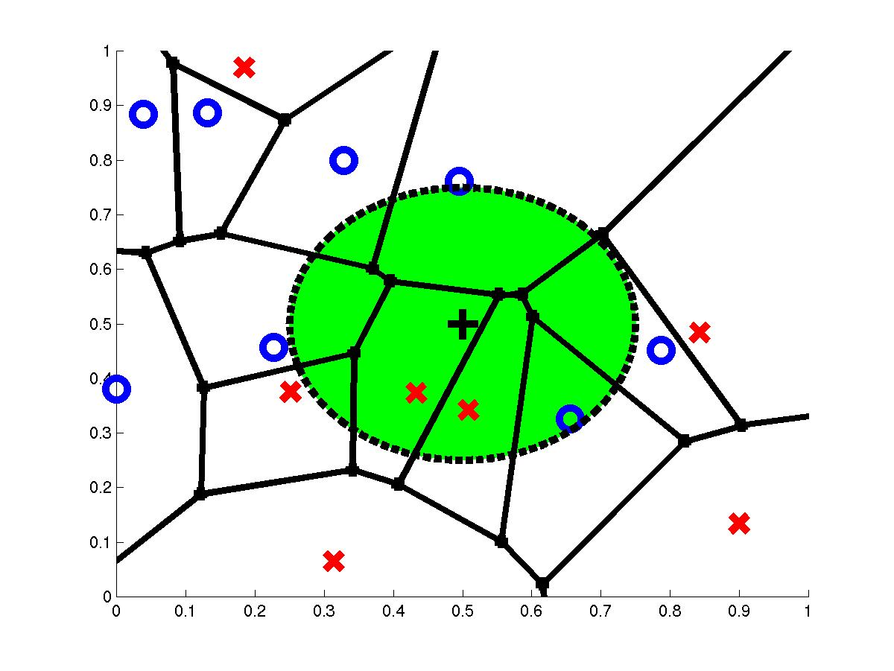
3-Nearest Neighbors
query point q_{f}
3 nearest neighbors
2x,1o

Slide 10
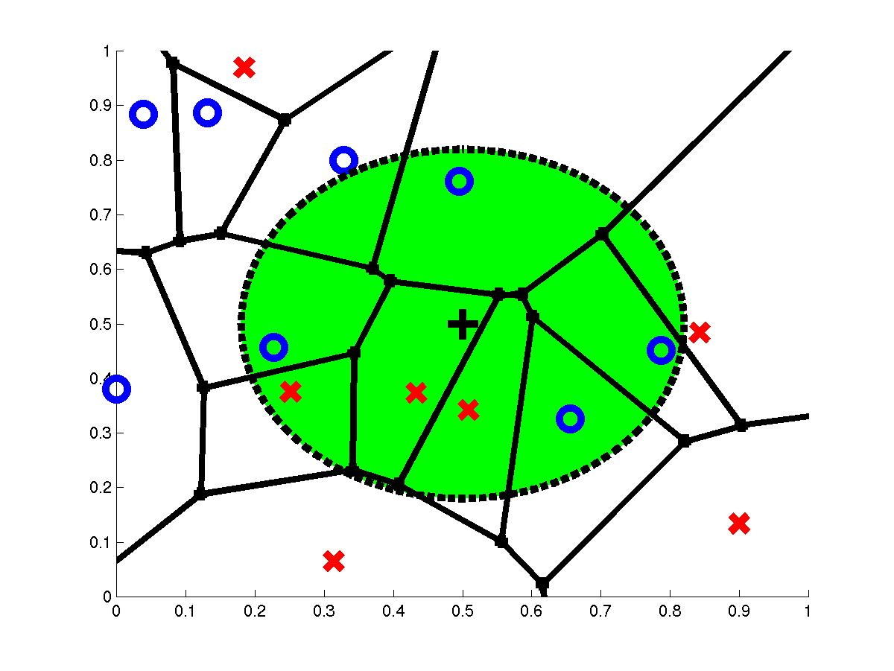
7-Nearest Neighbors
query point q_{f}
7 nearest neighbors
3x,4o

Slide 11
How to determine the good value for k?
Determined experimentally
Start with k=1 and use a test set to validate the error rate of the classifier
Repeat with k=k+2
Choose the value of k for which the error rate is minimum
Note: k should be odd number to avoid ties

Slide 12
1-NN’s Aspects as an Instance-Based Learner:
A distance metric
Euclidean
When different units are used for each dimension
→ normalize each dimension by standard deviation
For discrete data, can use hamming distance
→ D(x1,x2) =number of features on which x1 and x2 differ
Others (e.g., normal, cosine)
How many nearby neighbors to look at?
One
How to fit with the local points?
Just predict the same output as the nearest neighbor.

Slide 13
k – Nearest Neighbor
Generalizes 1-NN to smooth away noise in the labels
A new point is now assigned the most frequent label of its k nearest neighbors
Label it red, when k = 3
Label it blue, when k = 7

Slide 14
KNN Example
Similarity metric: Number of matching attributes (k=2)
New examples:
Example 1 (great, no, no, normal, no)
Example 2 (mediocre, yes, no, normal, no)
Yes
→ most similar: number 2 (1 mismatch, 4 match) → yes
→Second most similar example: number 1 (2 mismatch, 3 match) → yes
Yes/No
→ Most similar: number 3 (1 mismatch, 4 match) → no
→Second most similar example: number 1 (2 mismatch, 3 match) → yes
Notes:
Distance metric: Number of matching attributes
Example 1:
Most similar example: number 2 (1 mismatch, 4 match) -> classify yes
Second most similar example: number 1 (2 mismatch, 3 match) -> classify yes
Example 2:
Most similar example: number 3 (1 mismatch, 4 match) -> classify no
Second most similar example: number 1 (2 mismatch, 3 match) -> classify yes/no

Slide 15
Selecting the Number of Neighbors
Increase k:
Makes KNN less sensitive to noise
Decrease k:
Allows capturing finer structure of space
Pick k not too large, but not too small (depends on data)

Slide 16
k NEAREST NEIGHBOR
k = 1:
Belongs to square class
k = 3:
Belongs to triangle class
?
k = 7:
Belongs to square class
Choosing the value of k:
If k is too small, sensitive to noise points
If k is too large, neighborhood may include points from other classes
Choose an odd value for k, to eliminate ties
8
16

Slide 17
Curse-of-Dimensionality
Prediction accuracy can quickly degrade when number of attributes grows.
Irrelevant attributes easily “swamp” information from relevant attributes
When many irrelevant attributes, similarity/distance measure becomes less reliable
Remedy
Try to remove irrelevant attributes in pre-processing step
Weight attributes differently
Increase k (but not too much)
Notes:
Prediction accuracy can quickly degrade when number of attributes grows.
Imagine attribute vector (y,r1,r2,r3,…,rN),
first feature always tells the label
r1,..rn take random binary values.
What is the probability that nearest neighbor has same label? P(y=yNN)
Similarity measure is number of mismatches.
Assume we have only two training examples, one for each label. Both training examples have distance N+1 (all bits different) (-1,+1,-1,+1,-1,+1,…,-1) (+1,-1,+1,-1,+1,-1,…,+1)
If N=0, then P(y=yNN)=1
If N=2, then P(y=yNN)=3/4 → need both random attributes to match the wrong examples (4 outcomes on random attributes, and only one leads to a mistake)
If N=4, then P(y=yNN)=11/16 → need three random attributes to match the wrong examples (16 outcomes on random attributes, and 5 lead to a mistake)
If N=100, then P(y=yNN) almost 1/2 → need N/2+1 random attributes to match the wrong examples
For every random attribute, we need exponentially more training examples.

Slide 18
Advantages and Disadvantages of KNN
Need distance/similarity measure and attributes that “match” target function.
For large training sets,
Must make a pass through the entire dataset for each classification. This can be prohibitive for large data sets.
Prediction accuracy can quickly degrade when number of attributes grows.
Simple to implement algorithm;
Requires little tuning;
Often performs quite well!
(Try it first on a new learning problem).
Notes:
Need similarity measure and attributes that “match” target function
predicting a person’s height may depend on different attributes than predicting their IQ

Slide 19
Preprocessing your dataset
Dataset may need to be preprocessed to ensure more reliable data mining results
Conversion of non-numeric data to numeric data
Calibration of numeric data to reduce effects of disparate ranges
Particularly when using the Euclidean distance metric
https://machinelearningmastery.com/pre-process-your-dataset-in-r/

Slide 20
Non-numeric data
Feature values are not always numbers
Example
Boolean values: Yes or no, presence or absence of an attribute
Categories: Colors, educational attainment, gender
How do these values factor into the computation of distance?

Slide 21
Dealing with non-numeric data
Boolean values => convert to 0 or 1
Applies to yes-no/presence-absence attributes
Non-binary characterizations
Use natural progression when applicable; e.g., educational attainment: GS, HS, College, MS, PHD => 1,2,3,4,5
Assign arbitrary numbers but be careful about distances; e.g., color: red, yellow, blue => 1,2,3
How about unavailable data? (0 value not always the answer)

Slide 22
k-NN Time Complexity
Suppose there are m instances and n features in the dataset
Nearest neighbor algorithm requires computing m distances
Each distance computation involves scanning through each feature value
Running time complexity is proportional to n×m a time complexity of O(n×m)

Slide 23
WHY NEAREST NEIGHBOR?
Used to classify objects based on closest training examples in the feature space
Top 10 Data Mining Algorithm
ICDM paper – December 2007
Among the simplest of all Data Mining Algorithms
Classification Method
Implementation of lazy learner
All computation deferred until classification
?
23

Slide 24
QUESTION 1:
Compare and contrast k-Means and k-Nearest Neighbors. Be sure to address the types of these algorithms, the way neighborhoods are calculated and the number of calculations involved.
K-Means | K-Nearest Neighbors
Clustering algorithm | Classification Algorithm
Uses distance from data points to k-centroids to cluster data into k-groups. | Calculates k nearest data points from data point X. Uses these points to determine which class X belongs to
Centroids are not necessarily data points. | “Centroid” is the point X to be classified.
Updates centroid on each pass by calculations over all data in a class. | Data point to be classified remains the same.
Must iterate over data until center point doesn’t move. | Only requires k distance calculations.
39
24

Slide 25
QUESTION 2:
What are some major disadvantages of k-Nearest Neighbor Classification?
Classifying unknown records is relatively expensive:
Lazy learner; must compute distance over k neighbors
Large data sets → expensive calculation
Accuracy of regions declines for higher dimensional data sets
Accuracy is severely degraded by noisy or irrelevant functions
40
25

Slide 26
Lazy vs. Eager Learning
Lazy vs. eager learning
Lazy learning (e.g., instance-based learning): Simply stores training data (or only minor processing) and waits until it is given a test tuple
Eager learning: Given a set of training set, constructs a classification model before receiving new (e.g., test) data to classify
Lazy: less time in training but more time in predicting
Accuracy
Lazy method effectively uses a richer hypothesis space since it uses many local linear functions to form its implicit global approximation to the target function
Eager: must commit to a single hypothesis that covers the entire instance space

